Slide 1
Hello from Microsoft!
Suz Hinton – Technical Evangelist
Notes:
Hi, my name is Suz Hinton and I’m a technical evangelist at Microsoft – welcome to Big Red Hacks!
I’m super excited to be here and I’m looking forward to this weekend.

Slide 2
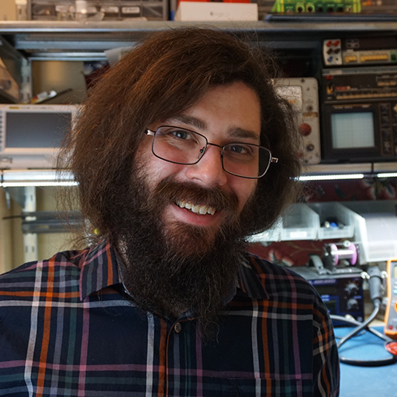


Meet Our Team
Andy Reitano Technical Evangelist
Mentor
IoT, hardware, TypeScript, JavaScript, electronics, maker, crowdfunding, Windows 10 IoT core, .NET, UWP
Suz Hinton Technical Evangelist
Mentor
IoT, electronics, JavaScript, NodeJS, web technologies, accessibility, cloud computing, continuous integration, chat bots, TypeScript
Rachel White Technical Evangelist
Mentor
JavaScript, Node.js, VR, AR, Azure, Cognitive Services, Bots, Hardware, IoT

Slide 3
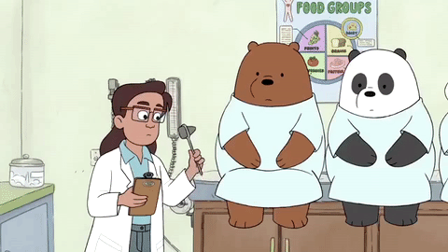
Need Any Help?
Notes:
Lots of knowledge between us - Data science / APIs / IoT / gaming etc

Slide 4
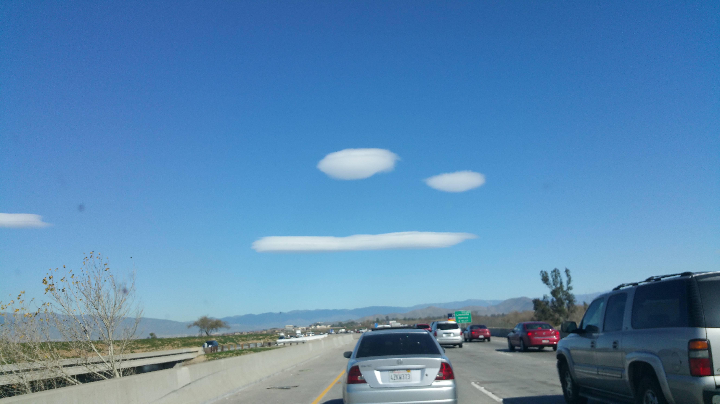
We have Cloud
(it’s https!)
Notes:
Azure

Slide 5
Quick things you can do with Azure
Deploy a web app
Build a mobile app backend for iOS, Android, or Windows
Store stuff… any stuff
Create a Linux or Windows Virtual Machine
Ingest massive amounts of data from IoT devices
Build & deploy a machine learning model

Slide 6
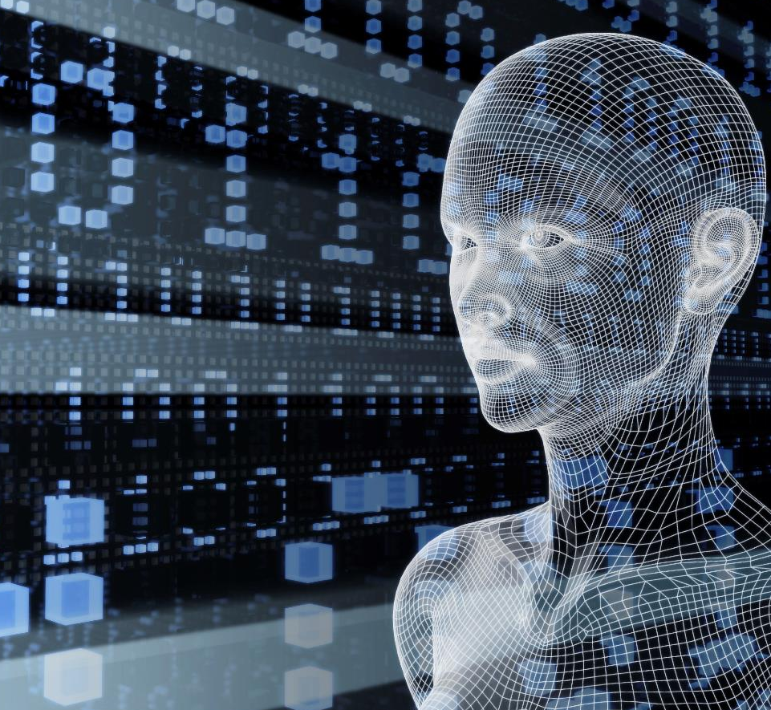
Cognitive Services API Collection
Microsoft Cognitive Services
Give your apps a human side
Enhance your hack!
Vision
Computer Vision | Emotion | Face | Video
Speech
Computer Recognition | Speaker Recognition Speech | Translator
Language
Bing Spell Check | Language Understanding Linguistic Analysis | Text Analytics | Web Language Model
Knowledge
Academic Knowledge | Entity Linking Knowledge Exploration | Recommendations
Search
Bing Autosuggest | Bing Image Search | Bing News Search Bing Video Search | Bing Web Search
Notes:
I love these APIs, too many to mention
Simple REST API, language agnostic, returns a a JSON string

Slide 7







Why Microsoft Cognitive Services ?
Easy
Flexible
Tested
Roll your own with REST APIs
Simple to add: just a few lines of code required
Make the same API code call on iOS, Android, and Windows
Integrate into the language and platform of your choice
Built by experts in their field from Microsoft Research, Bing, and Azure Machine Learning
Quality documentation, sample code, and community support
GET A KEY
BUILD

Slide 8

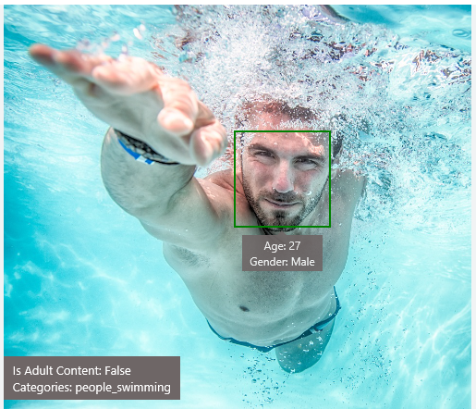
Analyze Image – Example
Type of Image:
Clip Art Type 0 Non-clipart
Line Drawing Type 0 Non-Line Drawing
Black & White Image False
Content of Image:
Categories [{ “name”: “people_swimming”, “score”: 0.099609375 }]
Adult Content False
Adult Score 0.18533889949321747
Faces [{ “age”: 27, “gender”: “Male”, “faceRectangle”: {“left”: 472, “top”: 258, “width”: 199, “height”: 199}}]
Image Colors:
Dominant Color Background White
Dominant Color Foreground Grey
Dominant Colors White
Accent Color

Slide 9
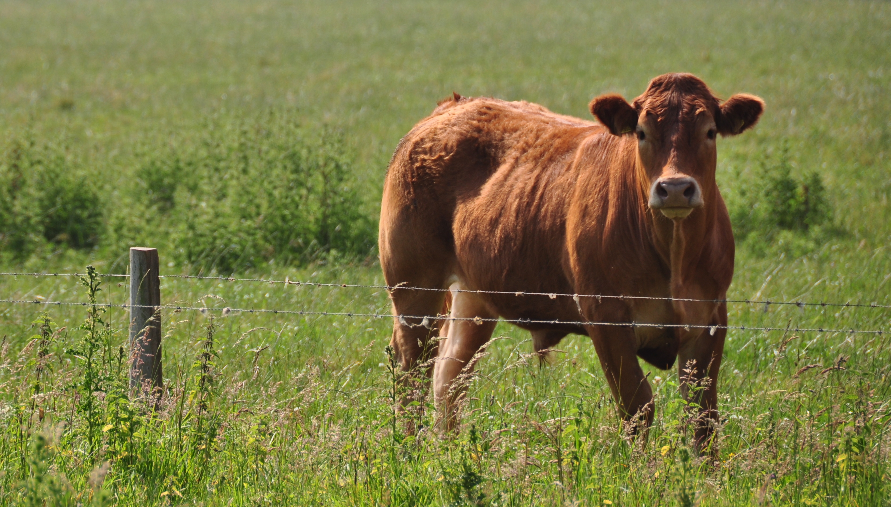
Computer Vision API
Content of Image:
Categories v0: [{ “name”: “animal”, “score”: 0.9765625 }]
V1: [{ "name": "grass", "confidence": 0.9999992847442627 },
{ "name": "outdoor", "confidence": 0.9999072551727295 },
{ "name": "cow", "confidence": 0.99954754114151 },
{ "name": "field", "confidence": 0.9976195693016052 },
{ "name": "brown", "confidence": 0.988935649394989 },
{ "name": "animal", "confidence": 0.97904372215271 },
{ "name": "standing", "confidence": 0.9632768630981445 },
{ "name": "mammal", "confidence": 0.9366017580032349, "hint": "animal" },
{ "name": "wire", "confidence": 0.8946959376335144 },
{ "name": "green", "confidence": 0.8844101428985596 },
{ "name": "pasture", "confidence": 0.8332059383392334 },
{ "name": "bovine", "confidence": 0.5618471503257751, "hint": "animal" },
{ "name": "grassy", "confidence": 0.48627158999443054 },
{ "name": "lush", "confidence": 0.1874018907546997 },
{ "name": "staring", "confidence": 0.165890634059906 }]
Describe
0.975 "a brown cow standing on top of a lush green field“
0.974 “a cow standing on top of a lush green field”
0.965 “a large brown cow standing on top of a lush green field”
Notes:
So easy, REST calls that return a JSON

Slide 10

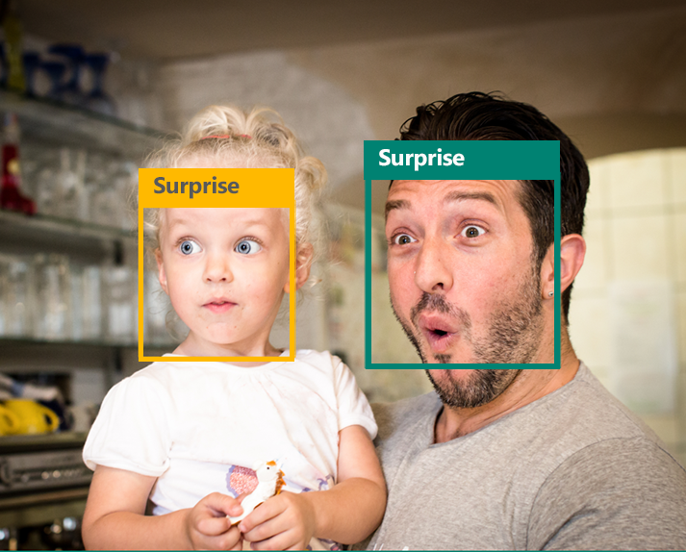
Emotion APIs
Face Detection
"faceRectangle": {"width": 193, "height": 193, "left": 326, "top": 204}
…
Emotion Scores
“scores": { "anger": 5.182241e-8,
"contempt": 0.0000242813,
"disgust": 5.621025e-7,
"fear": 0.00115027453,
"happiness": 1.06114619e-8,
"neutral": 0.003540177,
"sadness": 9.30888746e-7,
"surprise": 0.9952837}
Notes:
https://www.microsoft.com/en-us/garage/workbench-apps-details/Mimicker-Alarm/MimickerAlarm.aspx
To dismiss your alarm, we might ask you to snap a selfie, speak a phrase, or even get out of bed!

Slide 11
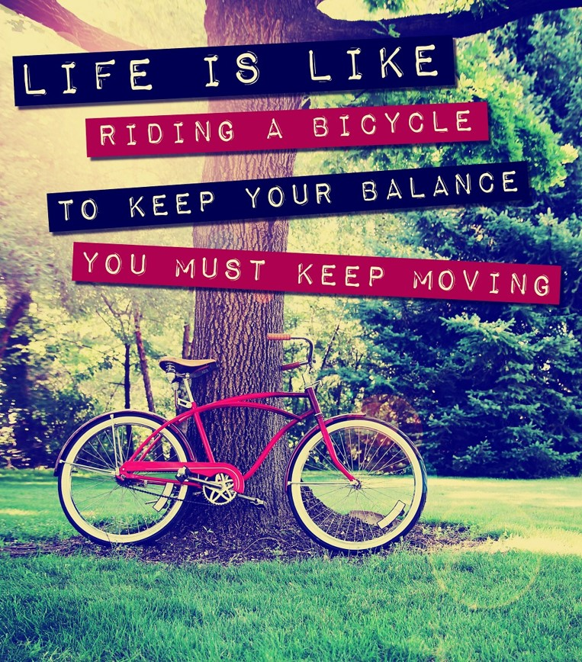
OCR (Optical character Recognition)
JSON:
{
"language": "en",
"orientation": "Up",
"regions": [
{
"boundingBox": "41,77,918,440",
"lines": [
{
"boundingBox": "41,77,723,89",
"words": [
{
"boundingBox": "41,102,225,64",
"text": "LIFE"
},
{
"boundingBox": "356,89,94,62",
"text": "IS"
},
{
"boundingBox": "539,77,225,64",
"text": "LIKE"
}
. . .
LIFE IS LIKE
RIDING A BICYCLE
TO KEEP YOUR BALANCE
YOU MUST KEEP MOVING

Slide 12
Demo(s)!

Slide 13

Cognitive Services
microsoft.com/cognitive
Vision
Speech
Language
Knowledge
Search
Computer Vision
Custom Recognition
Bing Spell Check
Academic Knowledge
Bing
Web Search
Emotion
Speaker Recognition
Linguistic Analysis
Entity Linking
Bing
Image Search
Face
Speech
Language Understanding
Knowledge Exploration
Bing
Video Search
Video
Translator
Text Analytics
Recommendations
Bing
News Search
WebLM
Bing
Autosuggest

Slide 14

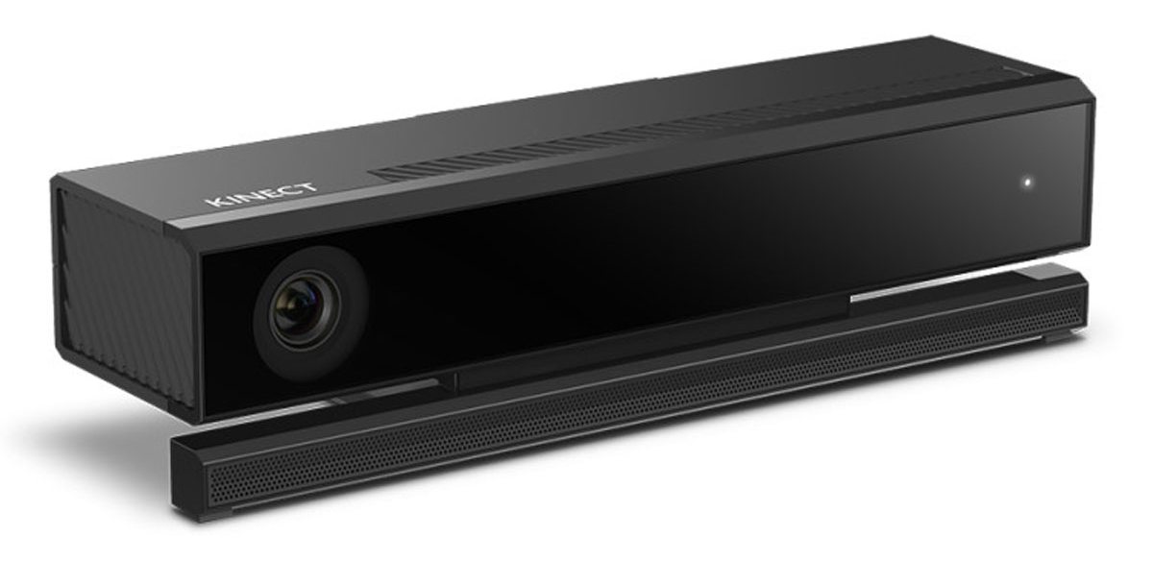
Available Loaners

Slide 15
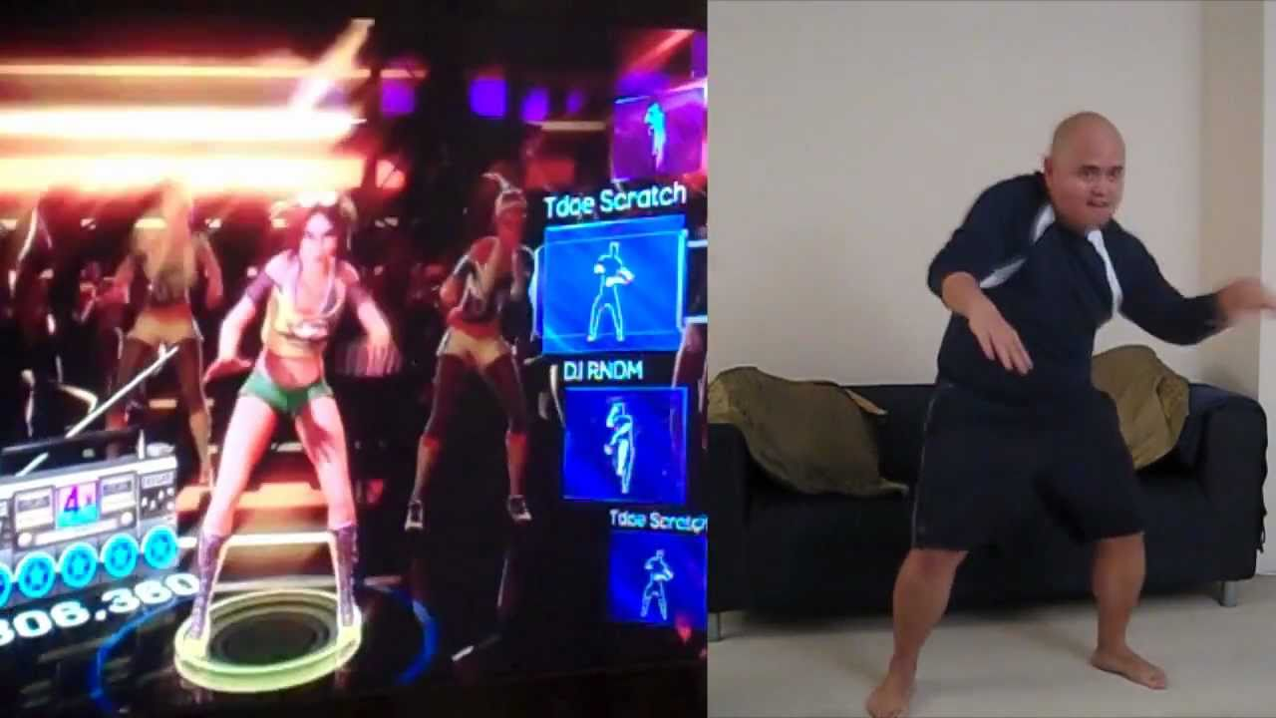
We have Kinects
Notes:
This should have been a gif

Slide 16
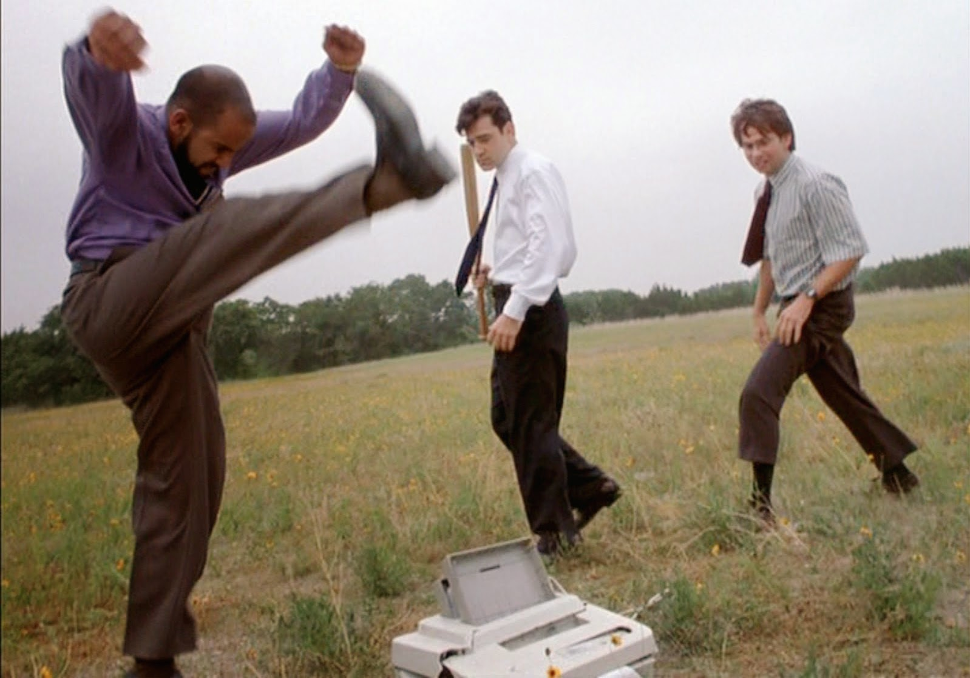
..And we have devices if yours is broken
Notes:
…maybe this one too

Slide 17
How to Win our Prize

Slide 18



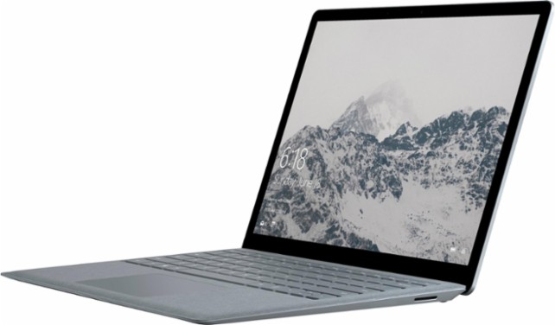


Best Microsoft Hack
Build on 1 or more and Win
Bot Framework
aka.ms/azurepasshack
dev.botframework.com
aka.ms/kinectdev-center
aka.ms/hololensdev-center
Cognitive Services aka.ms/cognitiveservices1
aka.ms/bingdev-center
up to 4
(1 per team member)
Visit aka.ms/api.lib for a complete API list.

Slide 19
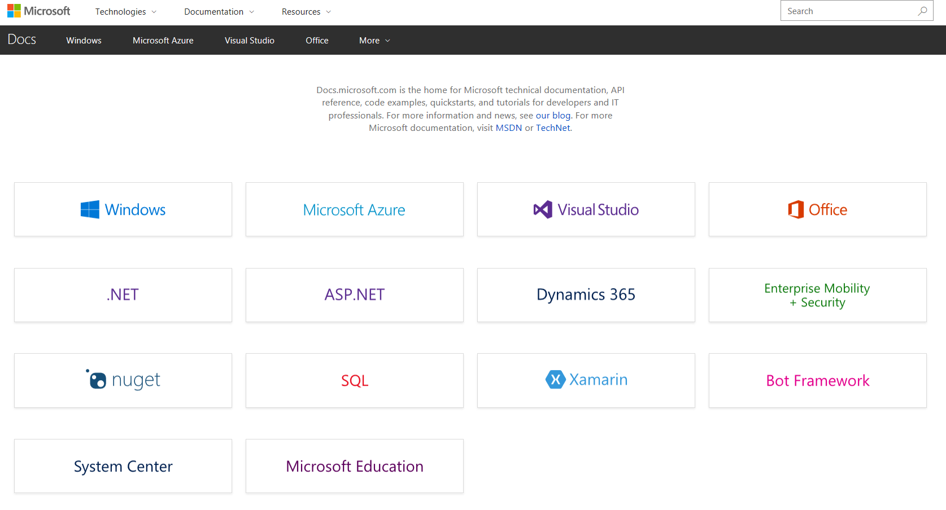
docs.microsoft.com

Slide 20

Sign up imagine.microsoft.com

Slide 21
Come say hi! We’re here all weekend

